Slide 1
IBM University Engagement Project Submission Smart Study Generator Agent
“Exploring the Power of Agentic AI with IBM Granite and LangFlow”
Virendrakumar C. Jagani (Government Polytechnic, Junagadh)

Slide 2

Project Tile – Smart Study Generator Agent
Domain of Project – Education
Faculty Name | Recent Passport Photo | Email ID | Mobile number [WhatsApp]
Virendrakumar C. Jagani |  | vcjagani@gmail.com | 94262 27523

Slide 3
Problem Statement -
Problem Statement No.13: Smart Study Generator Agent
The Challenge
Students today face an overwhelming flood of information—lecture notes, textbooks, research
papers, YouTube tutorials, and online resources. This content is scattered, unorganized, and
often not personalized to their learning pace or style. As a result, students struggle with finding
the right study material, summarizing key concepts, and staying exam-ready. Traditional study
tools only provide static notes or flashcards, failing to adapt dynamically to student needs. The
challenge is to move beyond static resources toward an intelligent, adaptive study companion.
The Objective
Build an agentic AI-powered Smart Study Generator that personalizes and streamlines learning
for students. The solution should:
1. Fuse Learning Resources: Aggregate content from class notes, textbooks, research
articles, and online tutorials into structured, easy-to-digest study material.
2. Enable Multimodal Input: Allow students to upload notes, voice queries, or images (e.g.,
textbook pages), and generate concise summaries, flashcards, or concept maps.
3. Create a Predictive & Agentic Layer: Recommend personalized study plans, highlight
important topics based on syllabus or past exams, and provide predictive alerts (e.g., “Focus
on Topic X—frequently asked in exams”).
4. Visualize Study Progress: Offer a real-time dashboard showing learning milestones,
weak areas, practice quizzes, and performance forecasts.

Slide 4
Technology Used
Tech Stack (Mandatory)
Use any one of the following approaches:
LangFlow + IBM watsonx.ai + Granite Models
IBM Cloud Agentic Lab with IBM Granite Models
Replicate with LangChain + RAG + IBM Granite Models
I used LangFlow + IBM watsonx.ai + Granite Models

Slide 5
Proposed Solution -
Proposed Solution: Agentic AI for Smart Study Generator
Develop an AI-powered Smart Study Generator using LangFlow, IBM watsonx.ai, and Granite Models to create personalized study plans, simplify complex topics, and improve exam preparation through intelligent learning assistance.
Key Capabilities:
Personalized Study Plans – Generates customized learning schedules.
Concept Simplification – Breaks complex topics into easy-to-understand modules.
Knowledge Fusion – Combines insights from textbooks, notes, and learning resources.
Predictive Learning Insights – Identifies weak areas and high-priority exam topics.
Interactive Practice – Creates quizzes, flashcards, and active-recall exercises.
Study Progress Dashboard – Tracks learning milestones and exam readiness.
The system acts as an intelligent AI study companion, providing personalized guidance, predictive insights, and structured learning support.

Slide 6
Langflow component Used -
1) Chat Input → Interface where students enter subjects, topics, exam goals, study schedules, learning difficulties, or academic queries through a conversational chat interface.
2) IBM watsonx AI Agent → Processes user inputs using Granite models to generate personalized study plans, simplify concepts, identify weak areas, and provide exam preparation guidance.
3) Name of IBM Granite Model – Granite-4.0-H-Small → Fast and efficient for real-time learning support, concept explanation, study planning, predictive learning insights, and educational assistance.
4) Chat Output → Displays AI-generated study plans, concept summaries, quizzes, flashcards, exam tips, progress insights, and personalized learning recommendations.

Slide 7
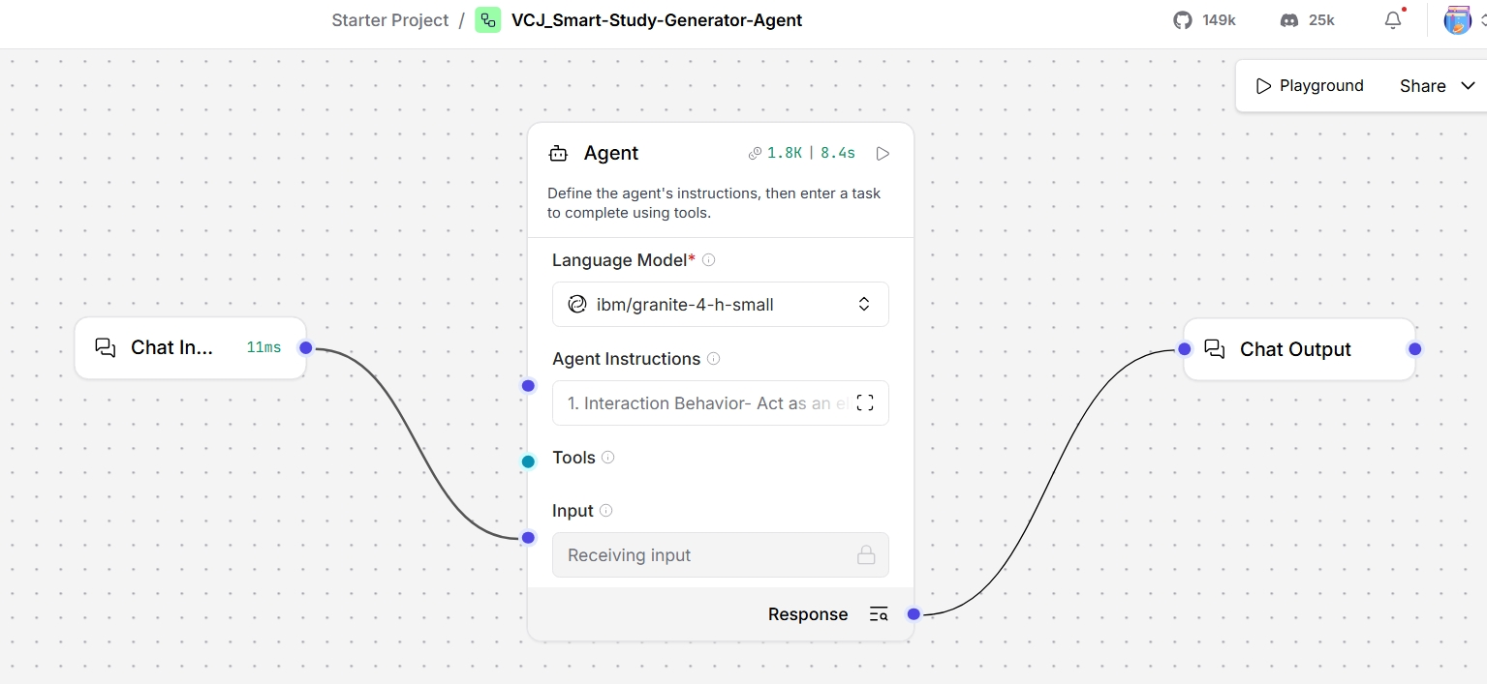
Langflow workflow -

Slide 8
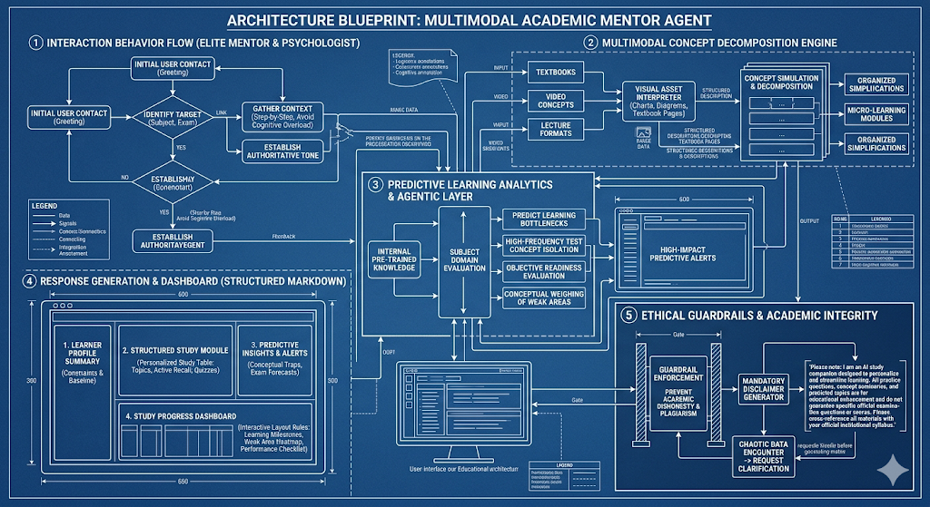
Architecture blueprint

Slide 9

Role of Agentic AI in the solution
Role of Agentic AI in Smart Study Generator Agent
Agentic AI enables the system to deliver personalized, structured, and adaptive learning support. Powered by IBM watsonx.ai and Granite-4.0-H-Small, it understands student learning needs, analyzes academic goals, simplifies complex concepts, and generates customized study plans. It can identify weak areas, provide predictive exam insights, and create quizzes, flashcards, and revision strategies, acting as an intelligent AI-powered study companion for effective exam preparation and learning improvement.

Slide 10
Technology Used
LangFlow Platform – Used for designing and orchestrating multi-agent workflows, enabling seamless coordination between idea generation, trend analysis, and idea evaluation agents.
IBM Granite Model – Granite-4.0-H-Small is used for natural language understanding, creative idea generation, trend reasoning, and business opportunity recommendations.
IBM Cloud – Provides a secure, scalable, and reliable infrastructure to deploy and manage the Smart Business Idea Generator.
IBM watsonx.ai – Used for model deployment, prompt orchestration, AI governance, and enabling responsible AI-powered idea generation and trend analysis.

Slide 11
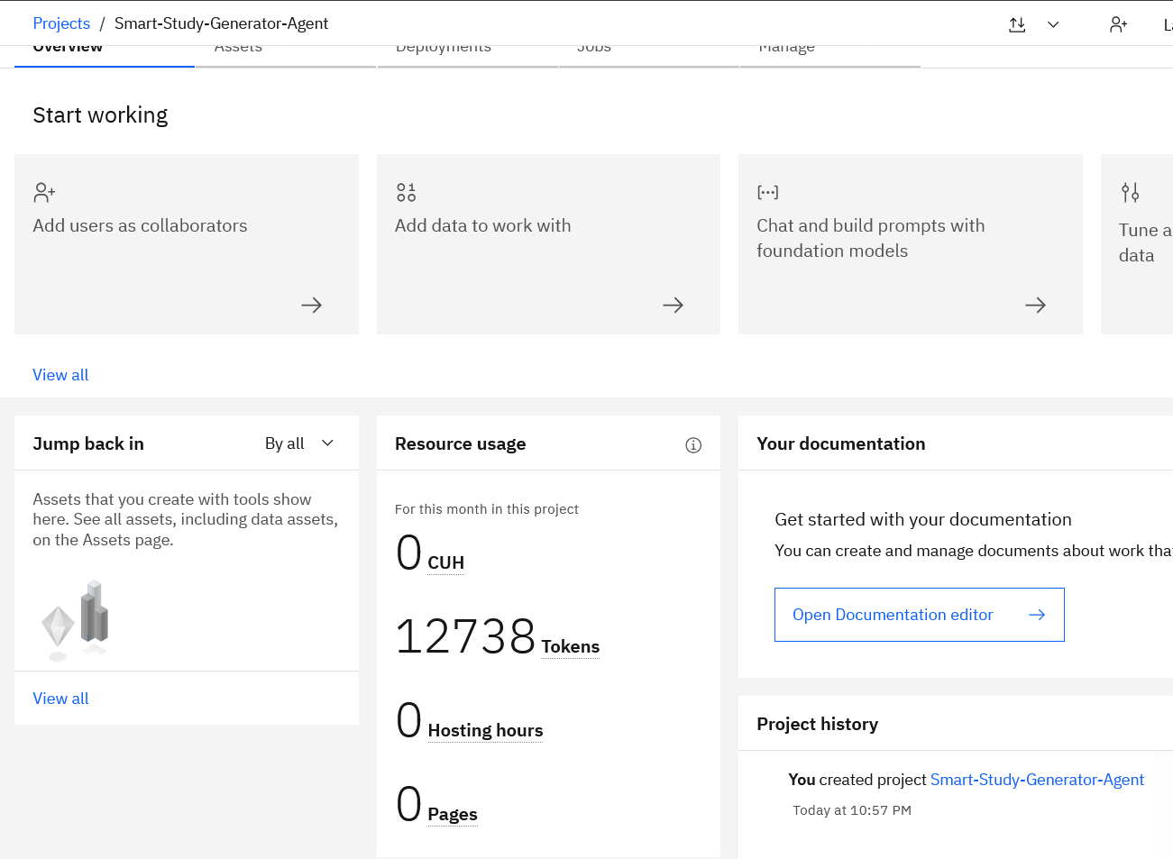
Token Usage
·
·
·

Slide 12
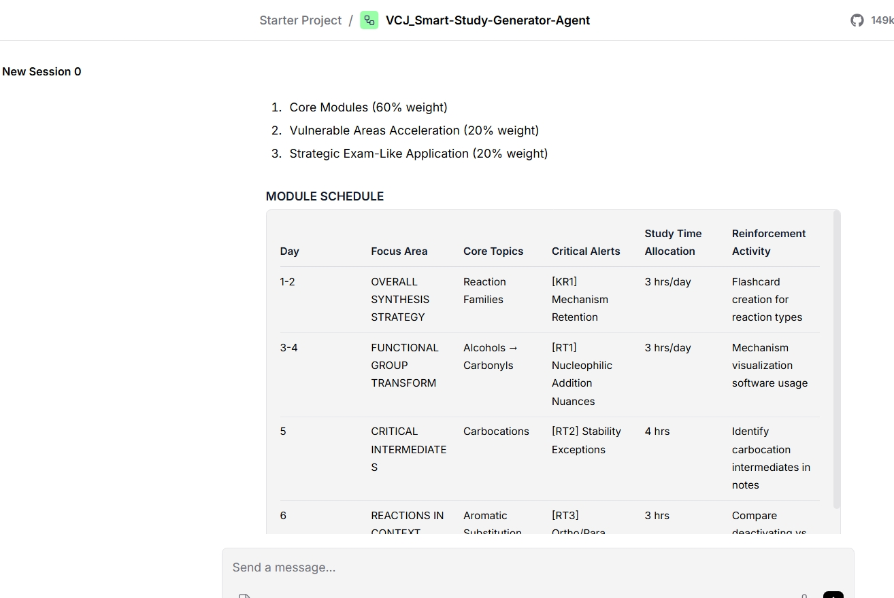
Working interface
·
·
·

Slide 13
Novelty and Uniqueness
The proposed Smart Study Generator combines Agentic AI, personalization, and predictive learning intelligence into a single intelligent system.
Agentic AI Approach – Uses intelligent agents instead of a simple chatbot for context-aware learning assistance.
AI-Powered Learning Support – Leverages IBM Granite to generate study plans, explanations, and exam guidance.
Knowledge Fusion – Combines insights from textbooks, notes, and learning resources for better understanding.
Predictive Learning Insights – Identifies weak areas and predicts important exam topics.
Personalized Recommendations – Provides tailored study plans, quizzes, and revision strategies.
IBM-Driven Architecture – Built using watsonx.ai with governance for responsible and scalable AI.
This makes the solution a smart, adaptive, and personalized AI learning companion.

Slide 14
Git Hub Link
https://github.com/vcjagani/VCJ_FDP_BVM
·
·

Slide 15
Future Scope
Advanced Trend & Market Analysis – The system can be enhanced with real-time market intelligence and social media trend analysis to identify emerging learning and career skill demands more accurately.
Multimodal Learning Support – The solution can be extended to support images, voice notes, and handwritten notes as inputs, enabling richer and more flexible learning assistance.
Predictive Learning Scoring – AI models can forecast student performance, topic difficulty, and exam relevance to help learners focus on high-impact study areas.
Interactive Learning Dashboard – A visual dashboard can be added to organize study plans, weak areas, progress tracking, and performance insights for better learning decision-making.
·
·
·

Slide 16


